Slide 1
Ratios - Introduction
Year 10 Mathematics

Slide 2
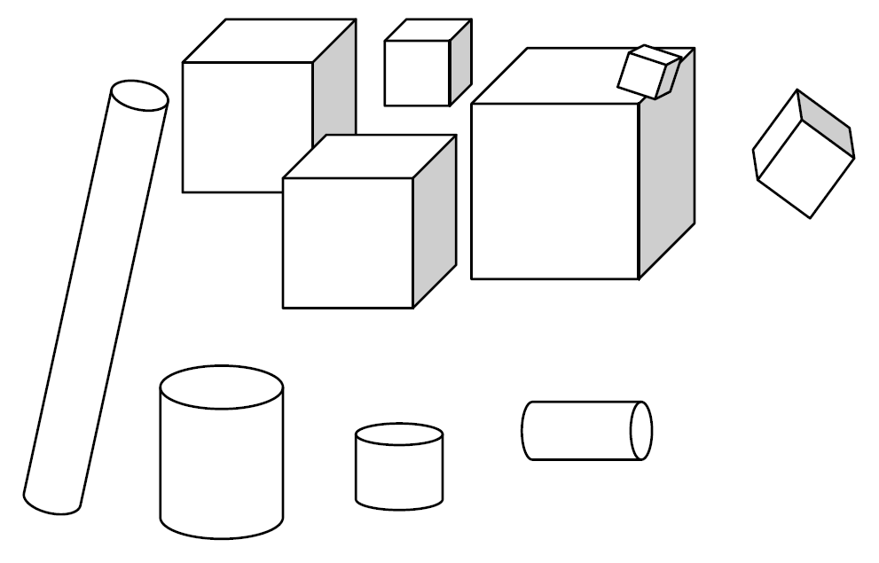
24
7
30
Date: /9/2018
Ratios
EQ – What is a ratio?
A ratio is a comparison of two or more quantities of the same type.
How many cylinders are there?
What is a ratio?
Example
How many cubes are there?
What fraction of the collection are cylinders?
What fraction of the collection are cubes?
What is the ratio of cubes to cylinders?
What is the ratio of cylinders to cubes?
25

Slide 3
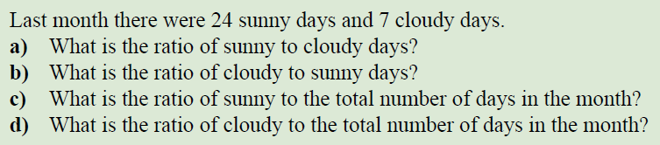
Let’s Do This One Together
Take away hint: Order of the ratio matters.

Slide 4
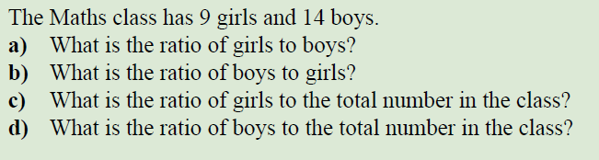
Task

Slide 5
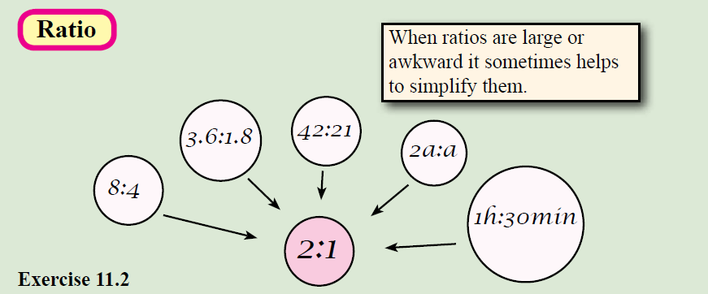

24
7
30
Date: /9/2018
Ratios
EQ – What is a ratio?
25

Slide 6
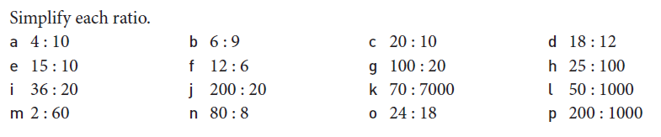
Task

